Slide 1

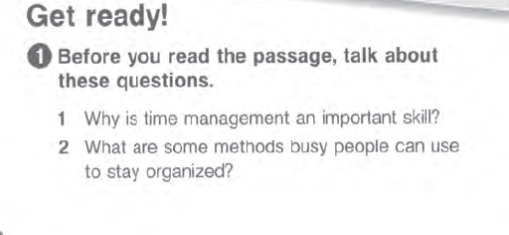
1-Time management is an important skill because
it allows you to use your time effectively, meet
deadlines and be punctual. Good time management
helps you to prioritize tasks, manage your workload
and ultimately, enjoy more free time, because you
don't have unfinished projects to complete at
home.
2- People can make to-do lists and then prioritize important tasks. Keeping a personal planner is
also an effective way of keeping track of upcoming appointments and deadlines. These
days, cell phones and computers have built in calendars and planners which can be an effective
tool in personal organization too.

Slide 2
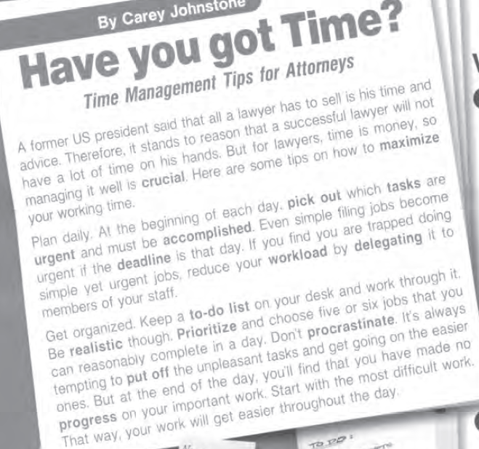
حاسم
اختر
ملح
الموعد الأخير
عبء العمل
واقعي
الأولوية
ماطل
تأجيل
تقدم

Slide 3
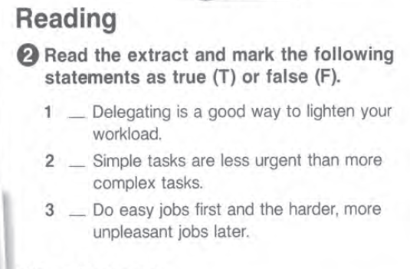
T
F
F

Slide 4

B
C
A
E
G
D

Slide 5
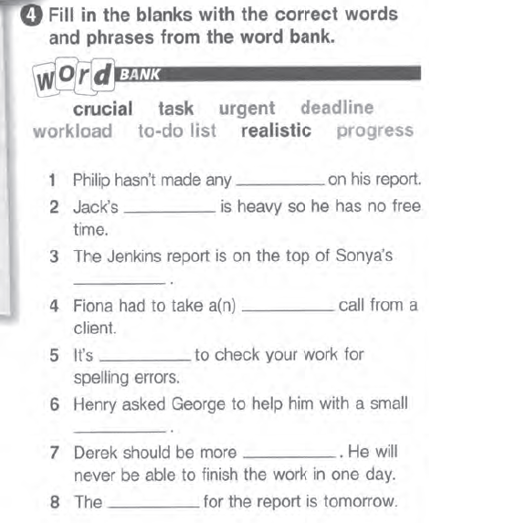
progress
workload
to-do list
urgent
crucial
task
realistic
deadline

Slide 6


Slide 7
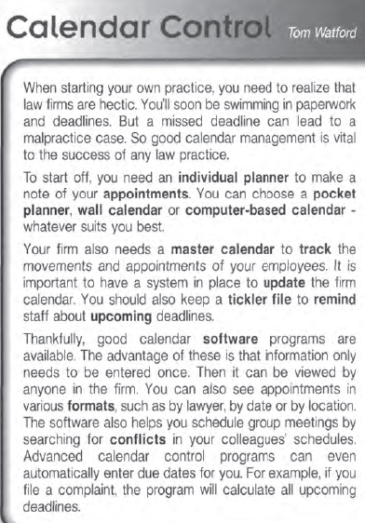

Slide 8
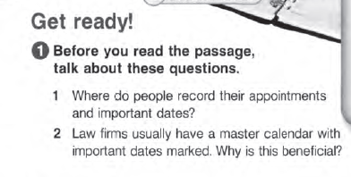
1- People record their appointments and deadlines in personal planners, on wall calendars and on
computer calendar programs.
2- It allows all the firm's employees to see what important cases and deadlines are coming up. It
also means employees can easily find out what other employees are working on, where they are
and when they have free time.

Slide 9
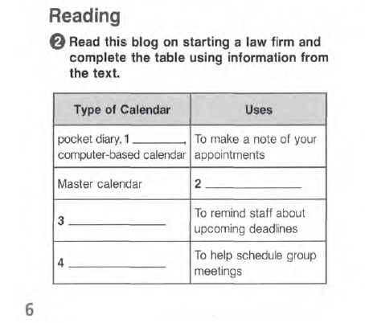
wall calendar
to track the movements and appointments of employees
tickler file
software program

Slide 10
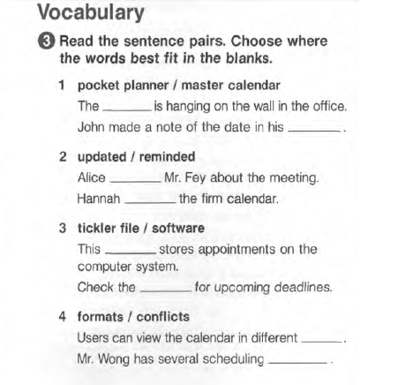
master calendar
pocket planner
reminded
updated
software
tickler file
formats
conflicts

Slide 11
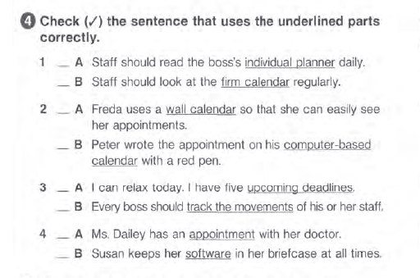

Slide 12

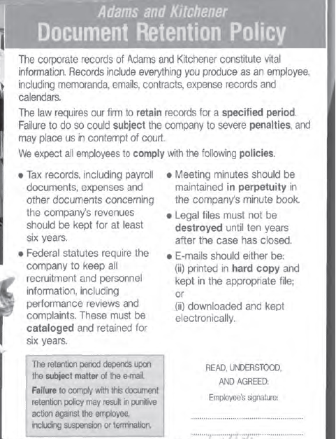
elde tutmak
razi bun

Slide 13
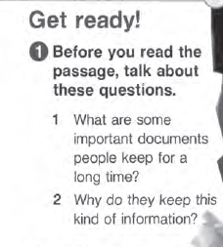
1- Important documents people keep for a long time include; birth and marriage certificates, driving licenses, degree certificates and other qualifications, financial and medical records.
2- These documents are important when you apply for jobs, loans, visas or study. Financial documents may be important for calculating taxes.

Slide 14
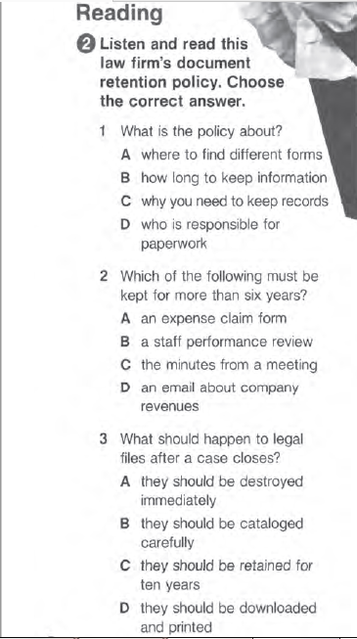

Slide 15
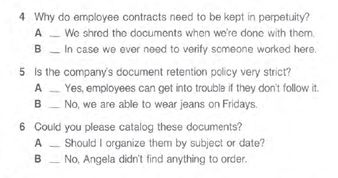
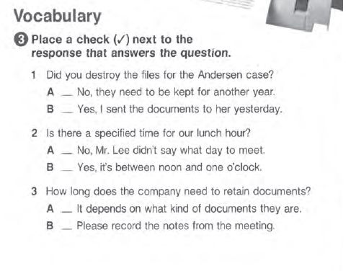

Slide 16
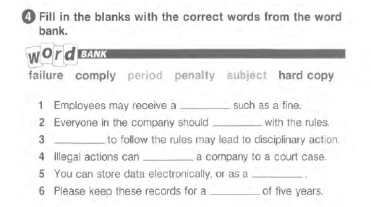
penalty
comply
failure
subject
hard copy
period

Slide 17

1 Some lawyers are not paid unless they win their cases because they do not charge an hourly rate but take a percentage of any damages awarded to their client. Lawyers choose this method of payment if they are fairly sure the case will be successful.
2 Lawyer's fees are expensive because a lawyer's education is expensive. Lawyers may have several years of university debt to pay back. Likewise, setting up a legal firm is an expensive business and usually requires lawyers to take out loans.

Slide 18
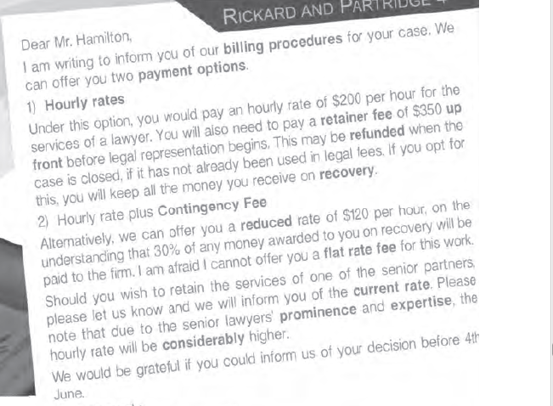

Slide 19
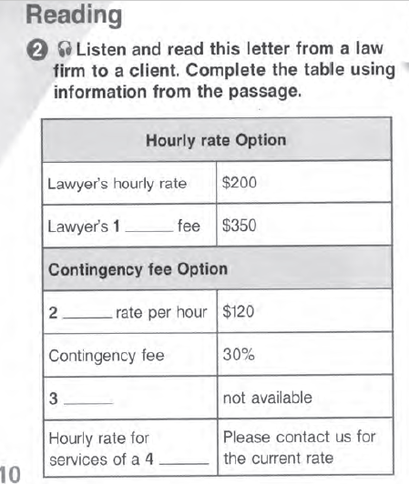
retainer
reduced
flat rate fee
senior partner

Slide 20
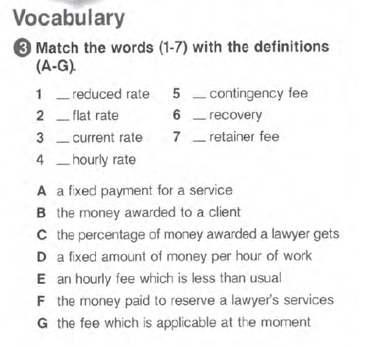
E
C
A
B
G
F
D

Slide 21
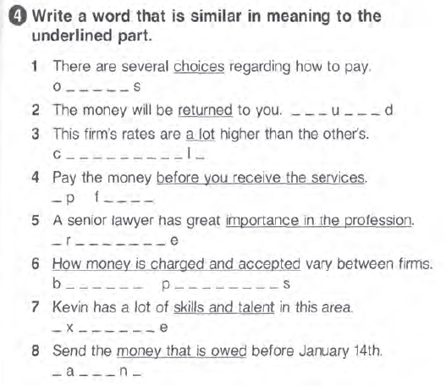
options
refunded
considerably
up front
prominence
billing procedures
expertise
payment

Slide 22
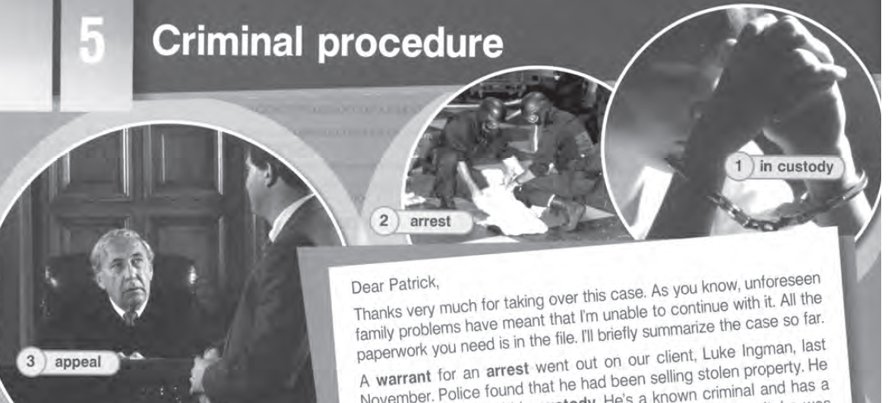
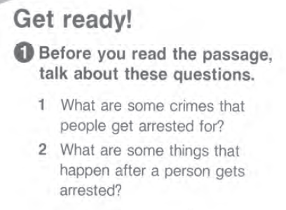
1-People can be arrested for breaking and entering,
theft, trespassing, assault and battery, murder, drug
crimes, human trafficking, drink driving, speeding etc.
2-After someone is arrested they are held in custody
and booked, which means a police officer notes
their personal details. Following this, they may be
offered bail, usually in return for a fee. The person
will then be formally charged with a crime and will
usually find a lawyer to argue their case.

Slide 23
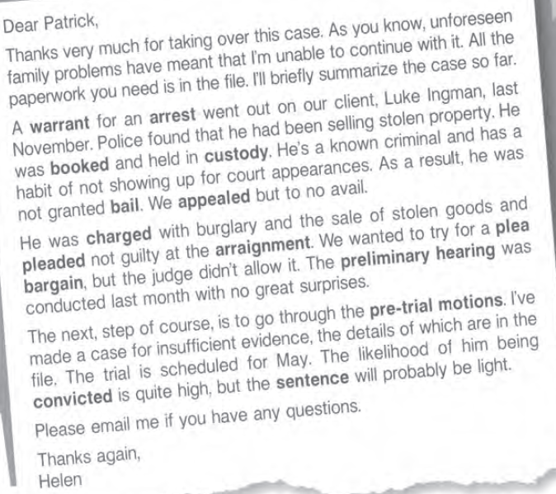
مذكرة
كفالة
صفقة المساومة
اتهام

Slide 24
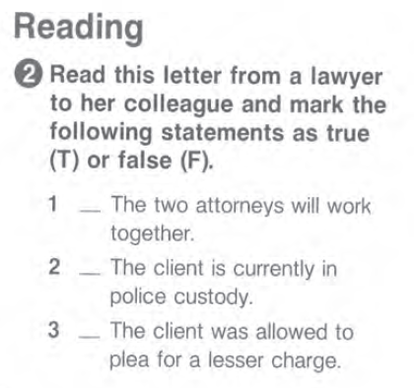
F
T
F

Slide 25
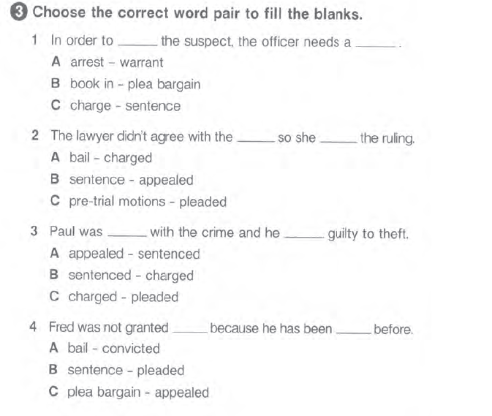

Slide 26
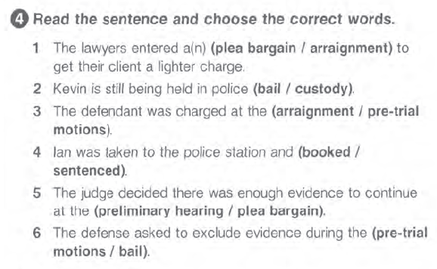

Slide 27

1- If a child commits a crime they may be taken into police custody and their parents or guardians will
be contacted. The child will then either be held in a juvenile correctional facility or allowed to go with
their parents or guardians. In either situation, the case is referred to a juvenile court which decides whether to try the child in court, or give them a lecture of the record about their offense. This depends on how serious the crime is.
2- In general, punishments for children are designed to punish the child for what they've done but to
also give them a chance to learn from their mistakes. They are generally less severe than adult punishments and often involve community service, probation and counseling. For more serious offenses, children may have to pay fines and even spend time in prison.

Slide 28


Slide 29
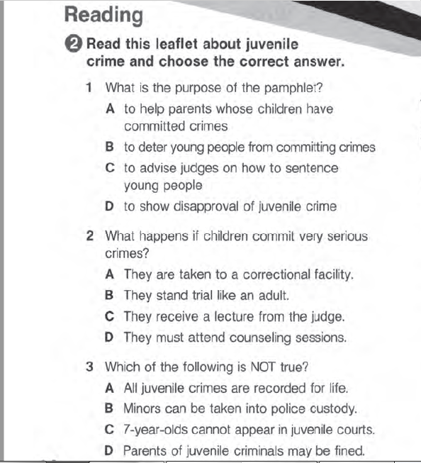

Slide 30
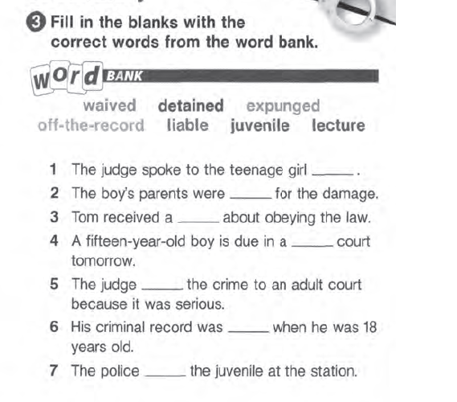
off-the-record
liable
lecture
juvenile
waived
expunged
detained

Slide 31
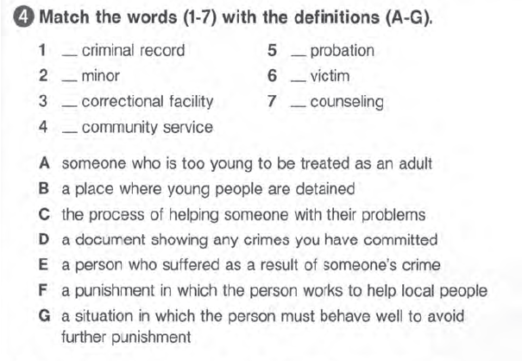
D
G
A
E
B
C
F

